Slide 2
ALL ABOUT
What is the Female Mentoring Alliance?
I truly believe in the power of women supporting women and this is why I have created this space to allow women to come together and support one another.
At the moment, I offer individual coaching and mentoring from myself or for individuals to take part in group mentoring sessions as well as join masterminds and online training.
Over time, I will be building a community that will bring together women of different backgrounds with the common belief of support and helping one another.

Slide 3
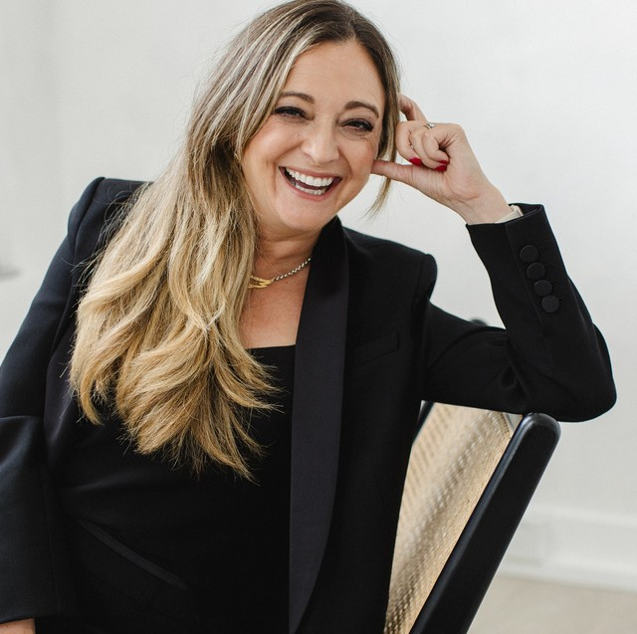
Jess Harvey
I’m Jess, a transformation coach , wife and mother and founder of the Female Mentoring Alliance.
I left my corporate banking career behind to embark on a journey of self-discovery and growth.
I help people unlock their potential and make the changes they need to thrive.
I focus on empowering clients to strengthen their foundation, trust their intuition, and make confident decisions.
Many coaches talk about manifesting and goal setting, but I know that real change requires a deeper, more personal approach.
FOUNDER
Using a three part transformation process of hearts and minds, goal setting and the environment I work with clients to build a strong foundation that supports personal growth and empowers action on their own terms.

Slide 4
WAYS TO WORK WITH ME PRIVATELY
TRANSFORMHER THE
TRANSFORMHER THE GROUP PROGRAMME
Group programme for a maximum of six attendees.
POWHER HOUR
A one hour session to look at a specific issue where a fast solution is needed .
EXECUTIVE 1-2-1 PROGRAMME
Individual coaching programme of six sessions.
Built around the transformation model that is used in the Executive Programme where once more expert guidance is provided to assist with personal strategise and actionable plans to bring clarity.
This could range from a difficult meeting or conversation to spend time focusing on personal skills. .
Built around a transformation model that focuses on mind, habits and environment the six sessions support the individual as they embark on the coaching journey.
Post the session a followup will check on progress made.
The sessions will be supported with powerful tools to maximise a systems based approach to change through a step by step progression.
This is set against the backdrop of a group programme providing a community connection where attendees learn from and support one another.
Support is provided between sessions via email and WhatsApp.
Sessions are held monthly walking through the transformation model.

Slide 5
HOW I SUPPORT COMPANIES
INDIVIDUAL COACHING GROUP COACHING
BESPOKE MENTORING PROGRAMMES
Mentoring programmes within organsiations can be very powerful and foster company values as well as providing connections across the organisation.
Individual coaching programmes of six sessions.
Providing companies with the exceptional opportunity to support cohorts on a journey of discovery.
Built around a transformation model that focuses on mind, habits and environment the six sessions support the individual as they embark on the coaching journey.
Based on a transformation model, cohorts of up to six will meet regularly to support one another as they work on areas of development.
Bespoke programmes are built with you to oversee the matching of mentor and mentee as well as training sessions to participants so that all are aware of the process.
Whilst all sessions remain confidential, the individual’s manager will be involved as well as feedback from key stakeholders sought to ensure maximum impact is felt from the programme.
This is an ideal programme for talent pools and can provide a great catalyst for organisational development.
Regular reminders and check ins are also provided to reduce the chance of loss in motivation.
Meetings with sponosres and regular updates ensure that the organisation’s objectives are met.
WORKSHOPS, EVENT SPEAKING AND PANEL DISCUSSIONS

Slide 6
If you wish to discuss further please feel free to:
Email: jessharvey@thefemalementoringalliance.com Call: 07980 298947
www.thefemalementoringalliance.com
Thank you Jess

